Slide 1
Sport Hub to buy sport tickets for different sport events in different cities for different games and leagues
Team - 3
Project Statement
By:-
Miraj Vekaria (A20504946)
Hemanth Thathireddy (A20525346)

Slide 2
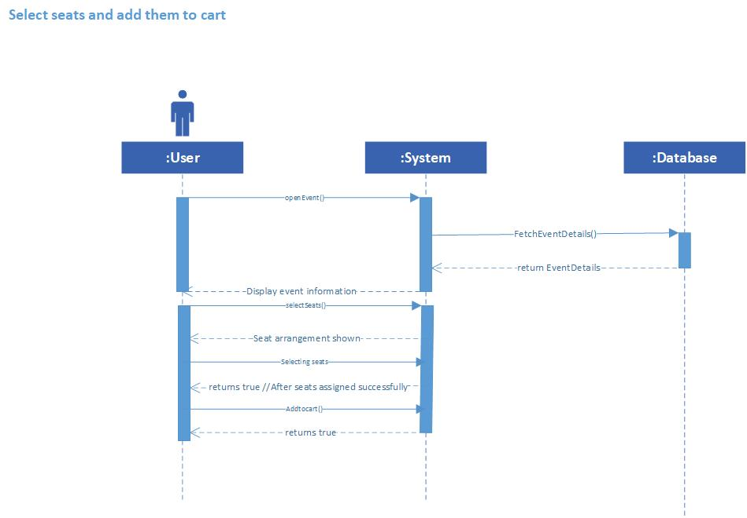
System Sequence Diagram

Slide 3
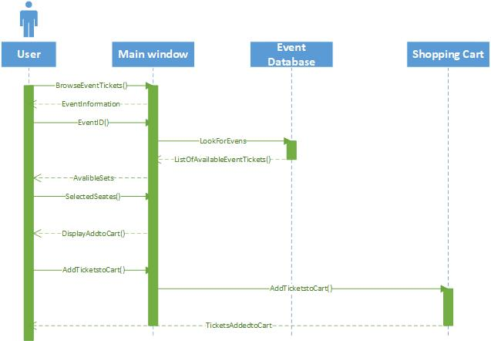
Sequence Interaction Diagram

Slide 4
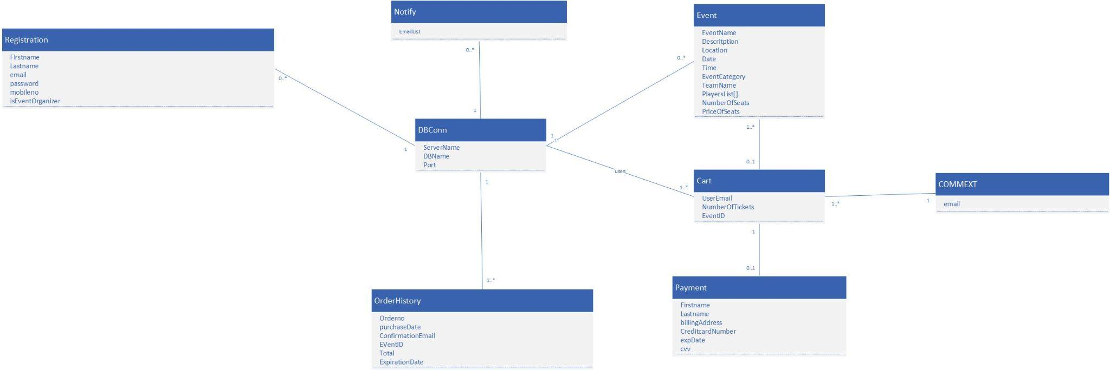
Domain Class Diagram

Slide 5
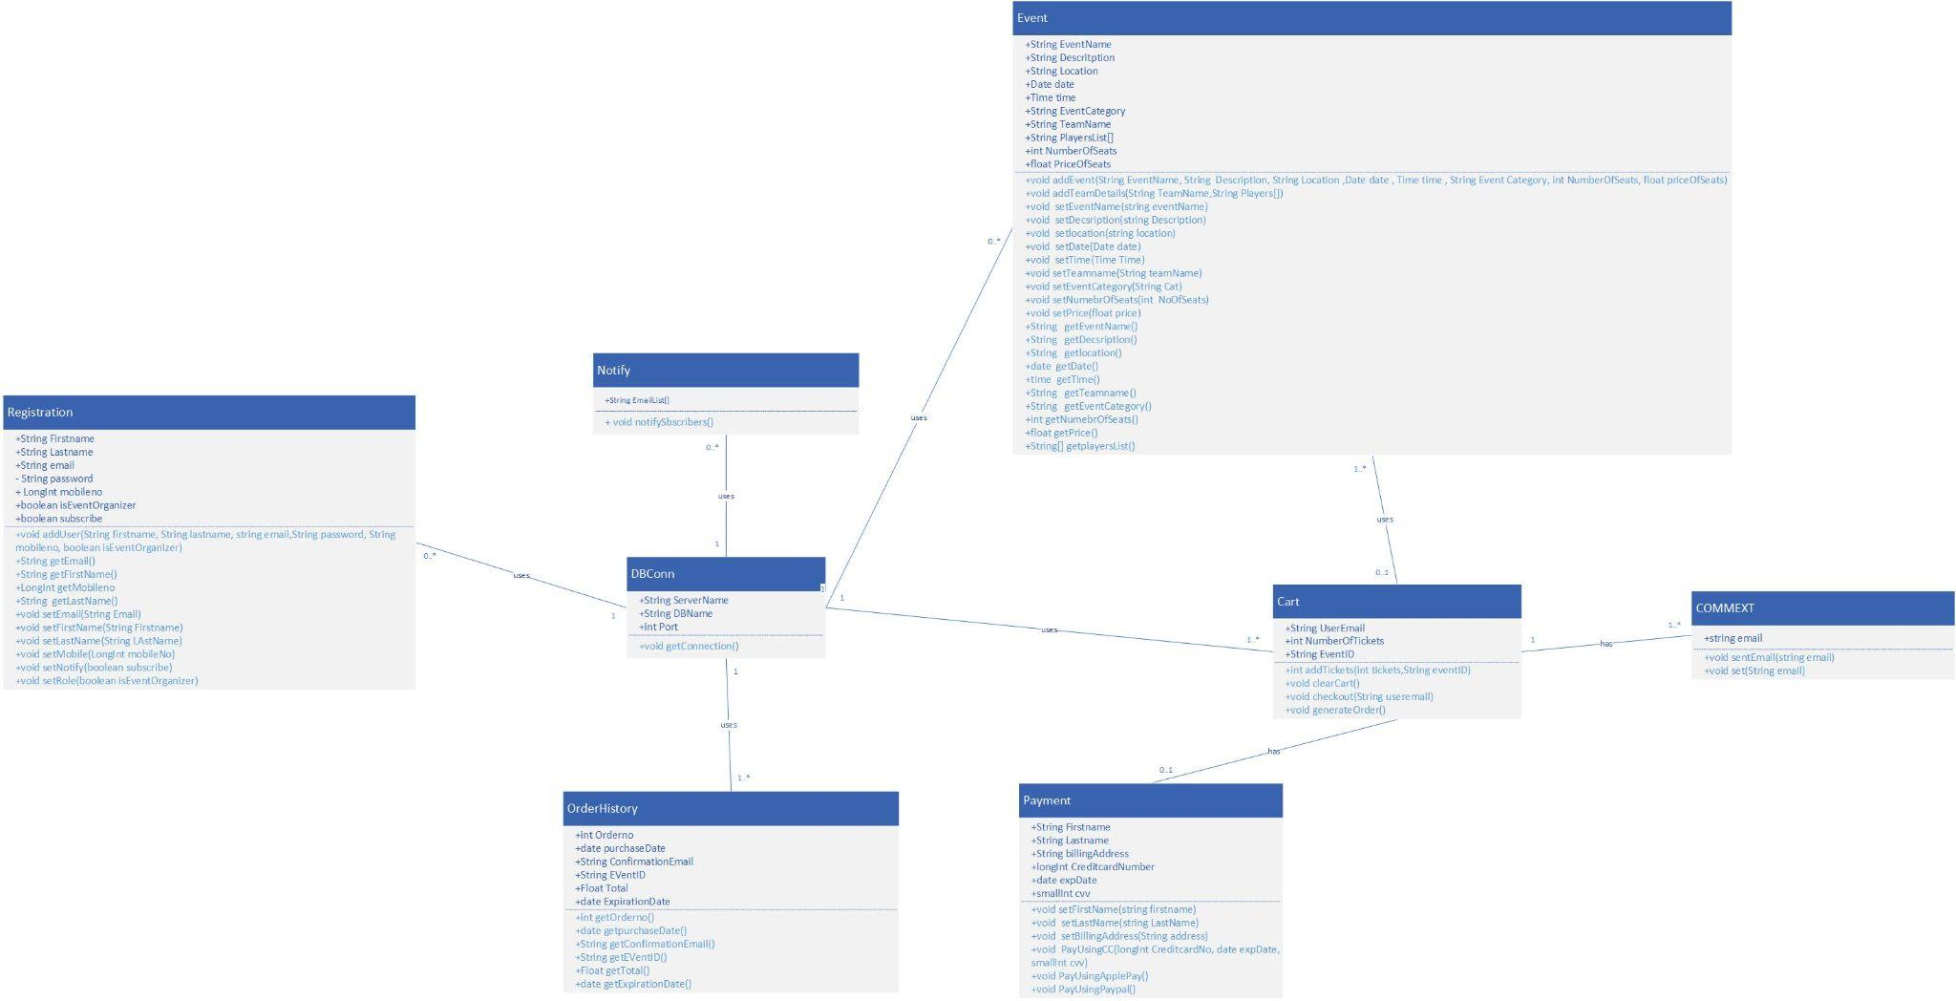
Design Class Diagram

Slide 6
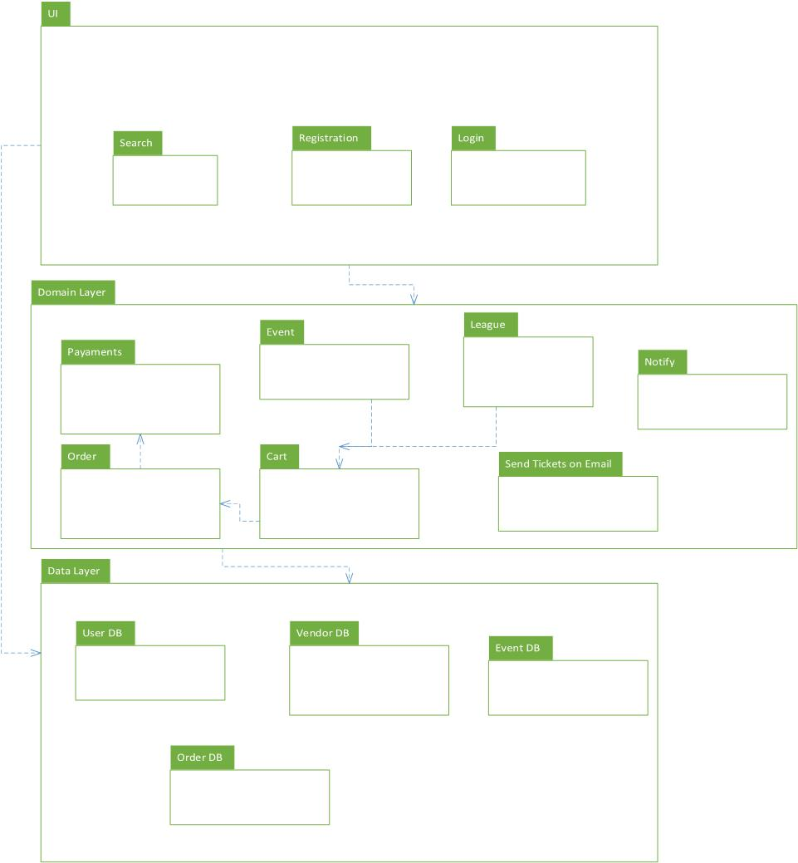
Package Diagram

Slide 7
Thank You

